Slide 1



Relatório de vendas_V2
View in Power BI
Last data refresh:
22/10/2024 00:57:24 UTC
Downloaded at:
26/10/2024 00:53:54 UTC

Slide 2
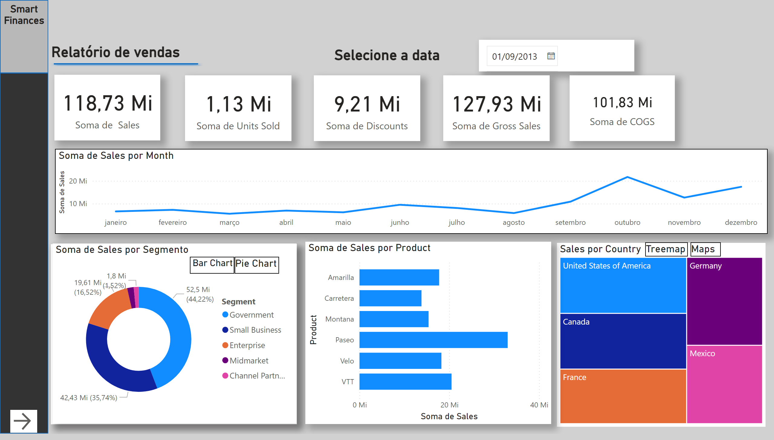
Página 1
Notes:
actionButton
No alt text provided
textbox
No alt text provided
shape
No alt text provided
shape
No alt text provided
Bar Chart
No alt text provided
Soma de Sales por Segmento
No alt text provided
barChart
No alt text provided
lineChart
No alt text provided
card
No alt text provided
card
No alt text provided
card
No alt text provided
card
No alt text provided
card
No alt text provided
textbox
No alt text provided
slicer
No alt text provided
shape
No alt text provided
textbox
No alt text provided
Pie Chart
No alt text provided
Sales por Country
No alt text provided
map
No alt text provided
Maps
No alt text provided
Treemap
No alt text provided
clusteredBarChart
No alt text provided
actionButton
No alt text provided

Slide 3
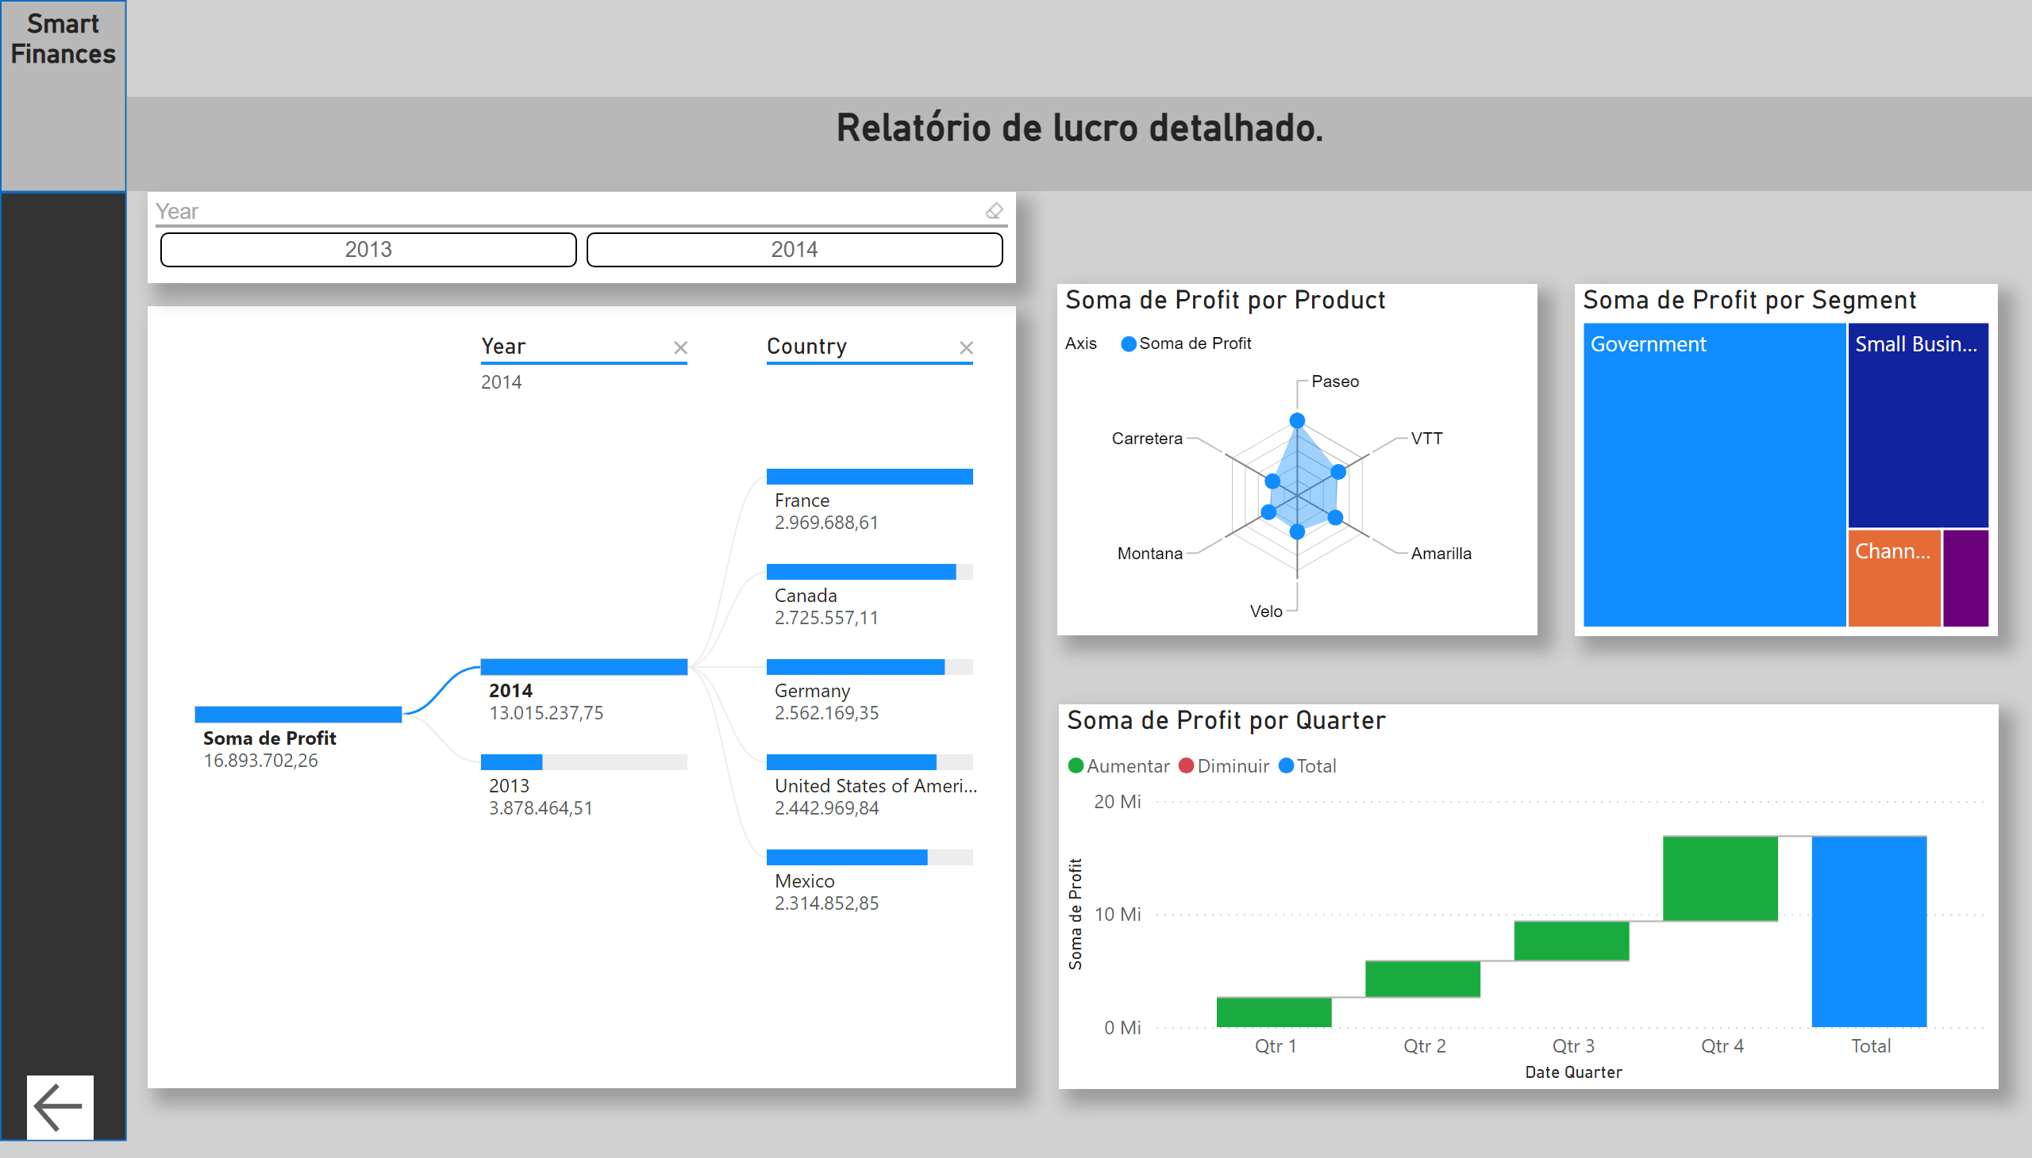
Página 2
Notes:
RadarChart1446119667547
No alt text provided
waterfallChart
No alt text provided
treemap
No alt text provided
decompositionTreeVisual
No alt text provided
ChicletSlicer1448559807354
No alt text provided
shape
No alt text provided
shape
No alt text provided
textbox
No alt text provided
textbox
No alt text provided
actionButton
No alt text provided

